Slide 1
Amazon Reviews Sentiment Analysis
Group 80
TRỊNH HUỲNH ANH THƯ 112353
NGUYỄN THỊ MỸ THANH 219733
NGÔ THỊ THANH LOAN 208015
NGUYỄN THỊ TƯỜNG VÂN 050362
NGUYỄN VĂN HUY 186300

Slide 2
AGENDA
1. Problem Definition
2. Data Collection
3. Data Preprocessing
4. Word Embedding
5. Splitting Data
6. Model Building
7. Model Training
8. Model Evaluation
9. QA

Slide 3
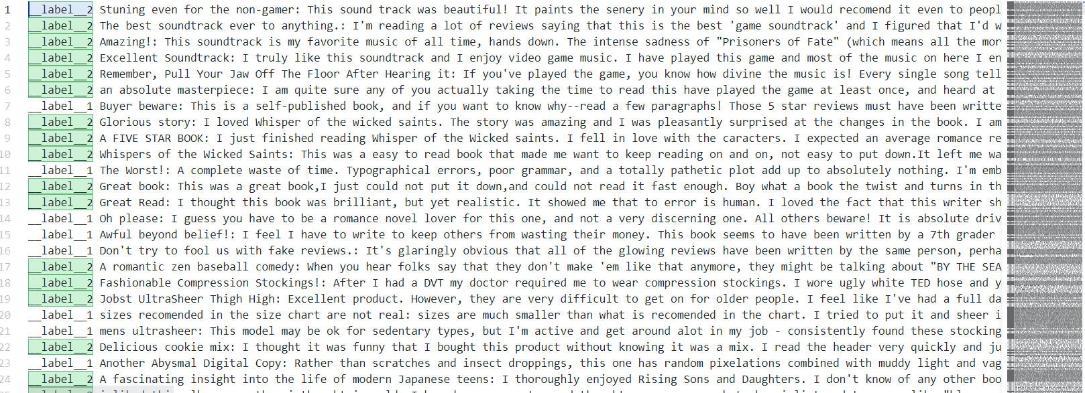
1. Problem Definition
The task: Sentiment analysis
The target labels: __label__<X>, features: review <text>

Slide 4

2. Data Collection
A dataset of Amazon reviews
https://www.kaggle.com/datasets/bittlingmayer/amazonreviews

Slide 5
3. Data Preprocessing
Loading Data: Load data to pandas.DataFrame
Text Cleaning: Remove unnecessary characters, HTML tags, URLs, etc
Lowercasing: Convert all text to lowercase to ensure uniformity
Tokenization: Split text into words (tokens)
Stop Words Removal: Remove common words that not be useful for the task, use nltk ‘English’ stopwords
Lemmatization/Stemming: Reduce words to their base or root form. Use Lemmatization
Handling Imbalanced Data: The data is balanced, no handle required

Slide 6
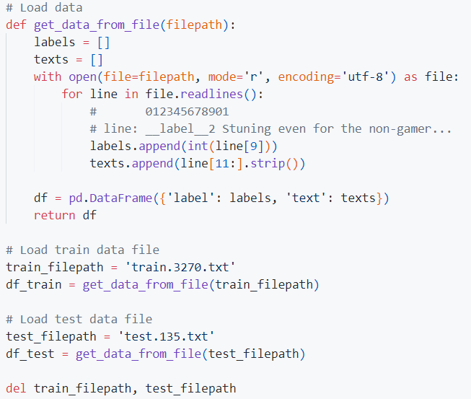
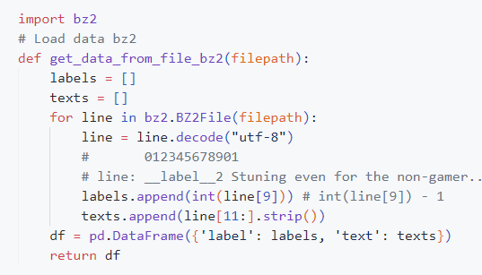
3. Data Preprocessing
Loading Data: Load data to pandas.DataFrame

Slide 7
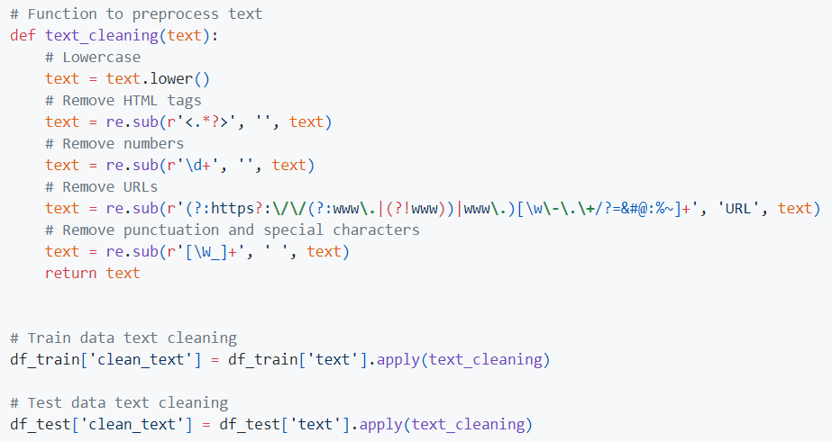
3. Data Preprocessing
Text Cleaning, Lowercasing

Slide 8
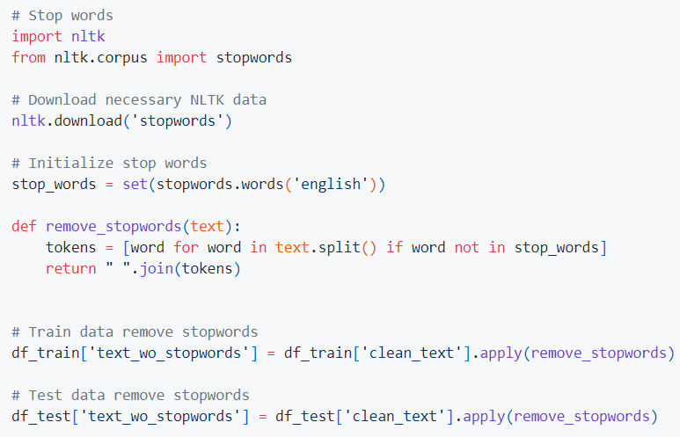
3. Data Preprocessing
Stop Words Removal: Remove words that not be useful, use nltk ‘English’ stopwords

Slide 9
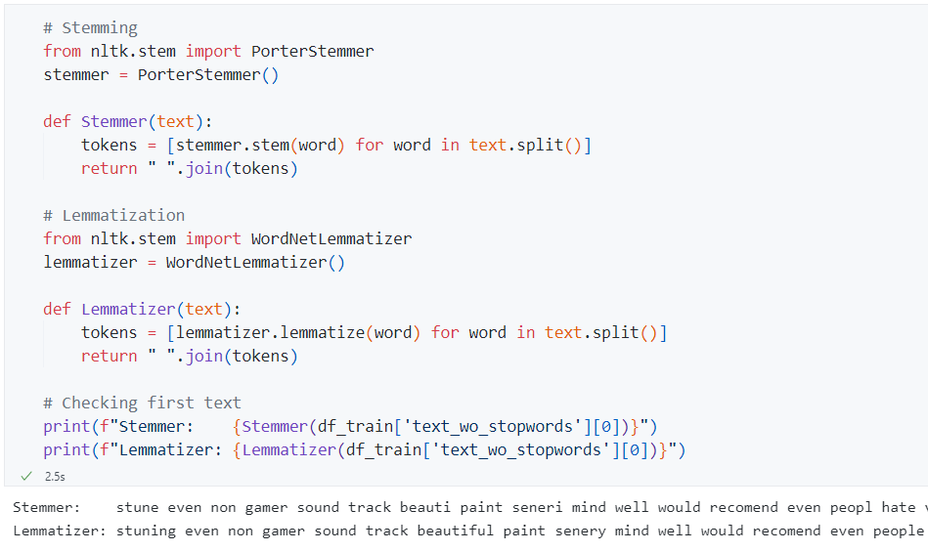
3. Data Preprocessing
Lemmatization/Stemming: Reduce words to their base or root form. Use Lemmatization

Slide 10
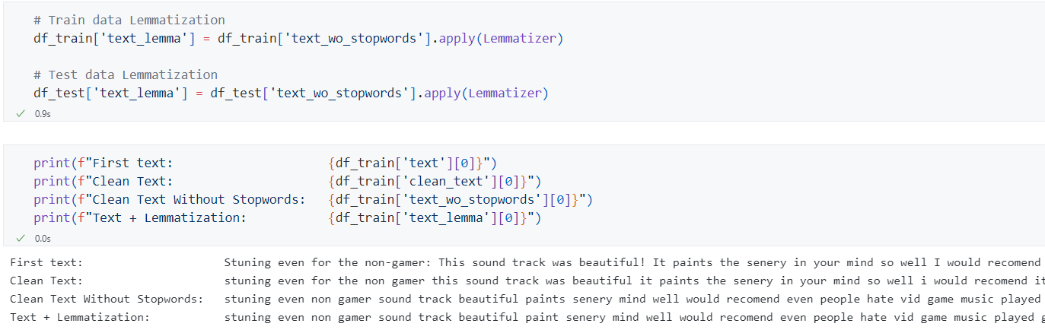
3. Data Preprocessing

Slide 11
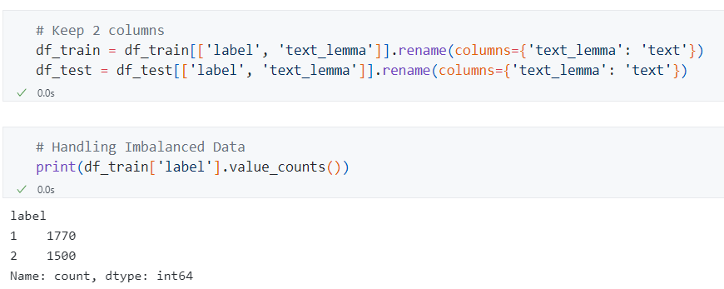
3. Data Preprocessing
Handling Imbalanced Data: The data is balanced, no handle required

Slide 12
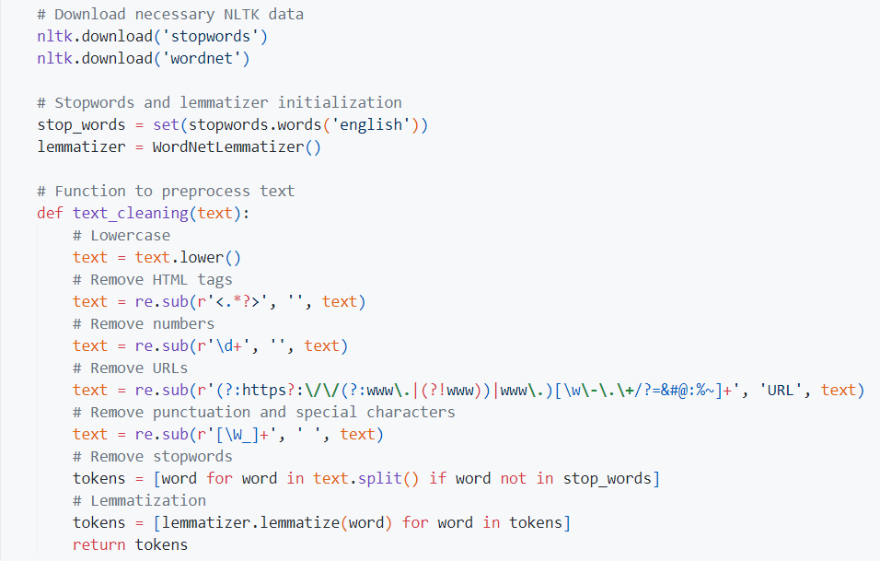
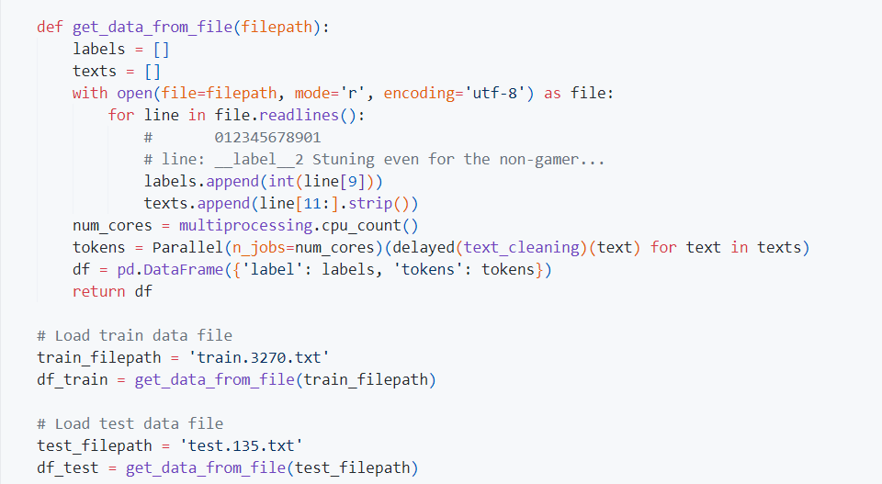
3. Data Preprocessing
Preprocessing with tokenization

Slide 13
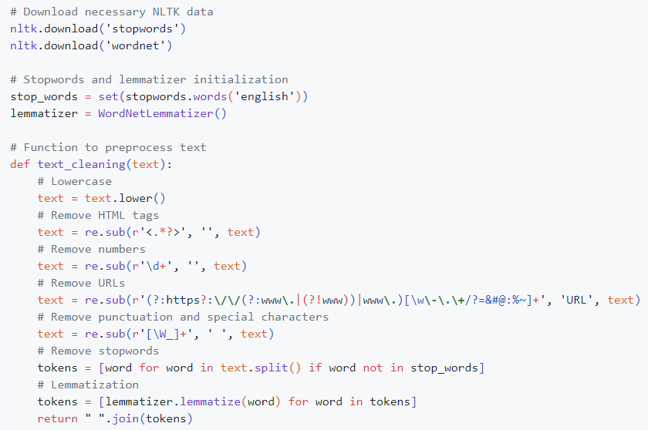
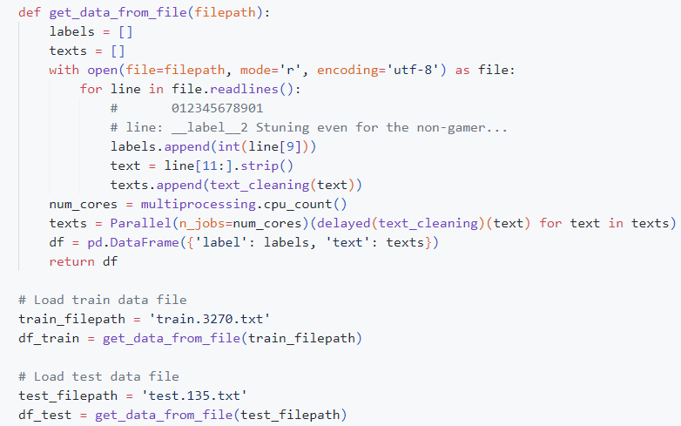
3. Data Preprocessing
Full steps preprocessing all-at-once

Slide 14
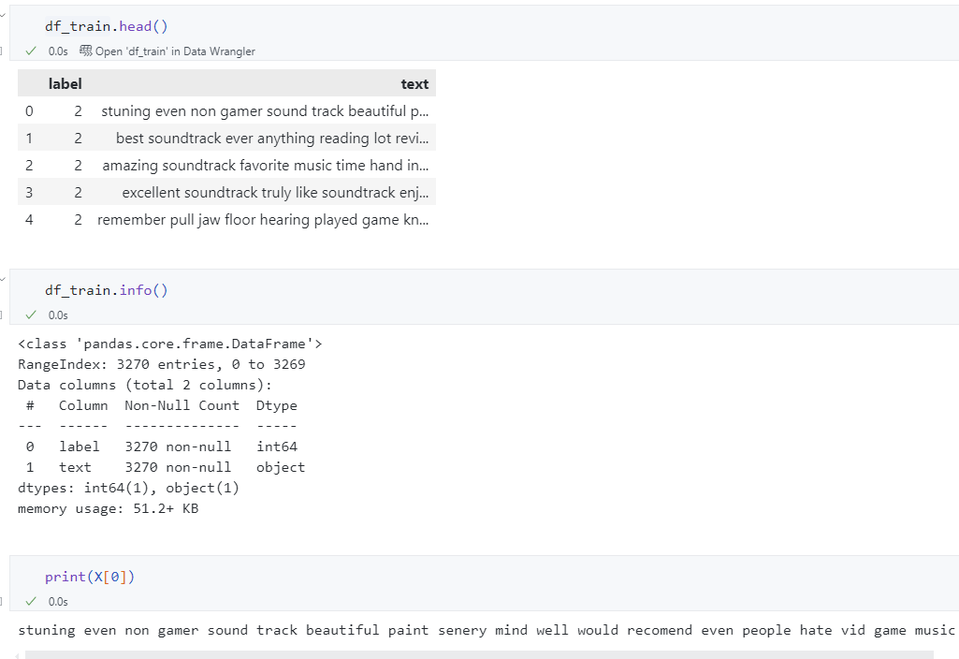
3. Data Preprocessing
Exploratory data analysis (EDA)

Slide 15
4. Word Embedding
Word embedding: Words or phrases are mapped to numeric vectors.
Word embeddings are mainly divided into 2 types:
Frequency-based embedding: count vector, TF-IDF vector, co-occurrence matrix, GloVe (global vector)
Prediction-based embedding: Word2vec (CBOW, Skip-gram), GloVe, FastText
Notes:
https://d2l.aivivn.com/chapter_natural-language-processing-pretraining/index_vn.html
https://viblo.asia/p/so-luoc-word-embedding-gDVK2RAeKLj
https://vinbigdata.com/kham-pha/word-embedding-so-sanh-cac-cach-tiep-can-truyen-thong-va-hien-dai.html

Slide 16
4. Word Embedding
Bag of Words (BoW): Create a matrix of token counts
TF-IDF (Term Frequency-Inverse Document Frequency): Convert texts to a matrix of TF-IDF features
Word Embeddings: Use pre-trained embeddings like Word2Vec, GloVe, FastText or train your own
Notes:
https://d2l.aivivn.com/chapter_natural-language-processing-pretraining/index_vn.html
https://viblo.asia/p/so-luoc-word-embedding-gDVK2RAeKLj
https://vinbigdata.com/kham-pha/word-embedding-so-sanh-cac-cach-tiep-can-truyen-thong-va-hien-dai.html

Slide 17
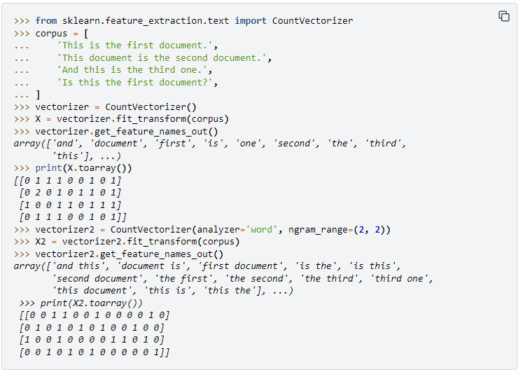
4. Word Embedding
Counter
Notes:
https://d2l.aivivn.com/chapter_natural-language-processing-pretraining/index_vn.html
https://viblo.asia/p/so-luoc-word-embedding-gDVK2RAeKLj
https://vinbigdata.com/kham-pha/word-embedding-so-sanh-cac-cach-tiep-can-truyen-thong-va-hien-dai.html

Slide 18
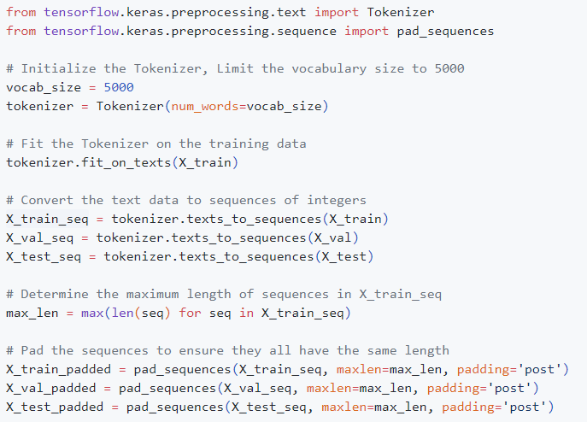
4. Word Embedding
Bag of Words (BoW): Create a matrix of token counts
Notes:
https://en.wikipedia.org/wiki/Bag-of-words_model

Slide 19
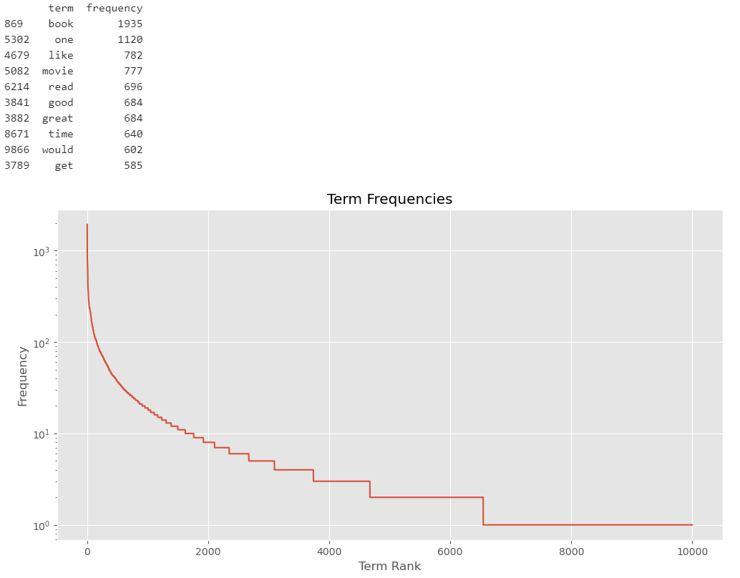
4. Word Embedding
Bag of Words (BoW)
Notes:
https://d2l.aivivn.com/chapter_natural-language-processing-pretraining/index_vn.html
https://viblo.asia/p/so-luoc-word-embedding-gDVK2RAeKLj
https://vinbigdata.com/kham-pha/word-embedding-so-sanh-cac-cach-tiep-can-truyen-thong-va-hien-dai.html

Slide 20
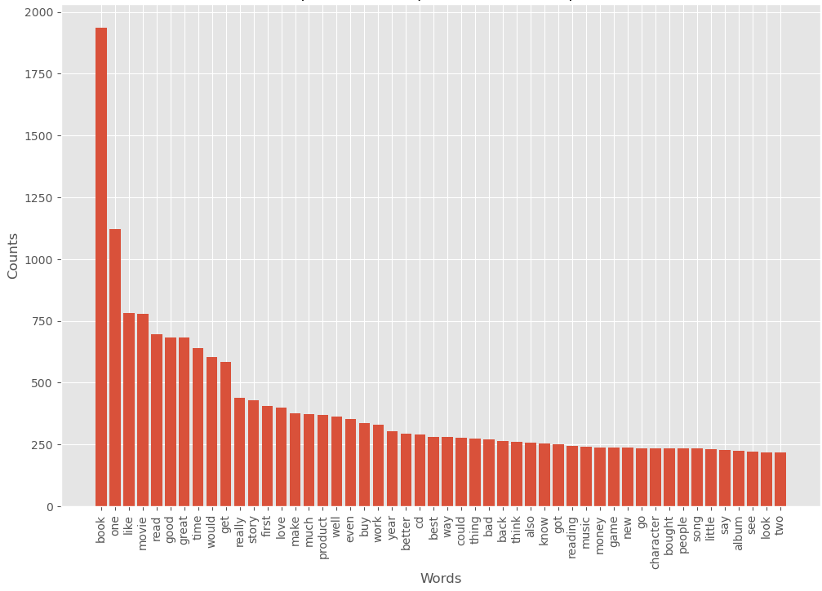
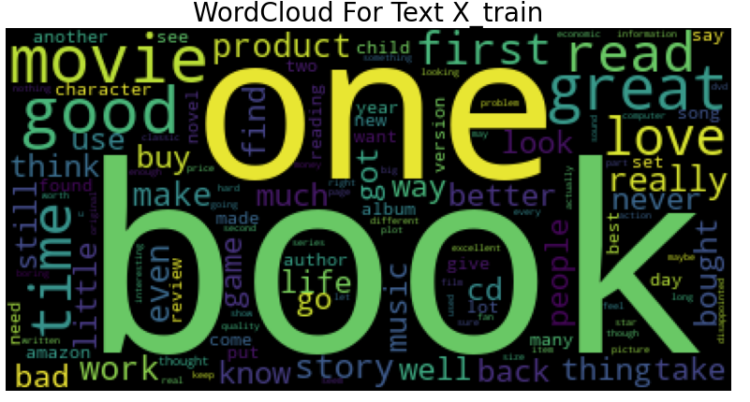
4. Word Embedding
Notes:
https://d2l.aivivn.com/chapter_natural-language-processing-pretraining/index_vn.html
https://viblo.asia/p/so-luoc-word-embedding-gDVK2RAeKLj
https://vinbigdata.com/kham-pha/word-embedding-so-sanh-cac-cach-tiep-can-truyen-thong-va-hien-dai.html

Slide 21
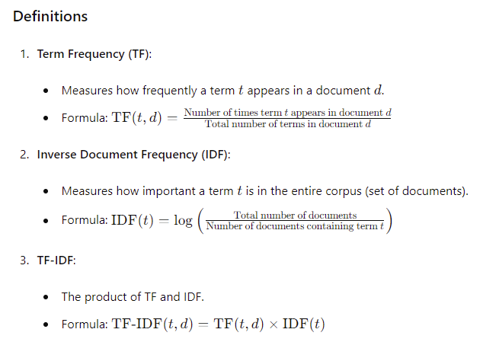
4. Word Embedding
TF-IDF:
Notes:
https://d2l.aivivn.com/chapter_natural-language-processing-pretraining/index_vn.html
https://viblo.asia/p/so-luoc-word-embedding-gDVK2RAeKLj
https://vinbigdata.com/kham-pha/word-embedding-so-sanh-cac-cach-tiep-can-truyen-thong-va-hien-dai.html

Slide 22
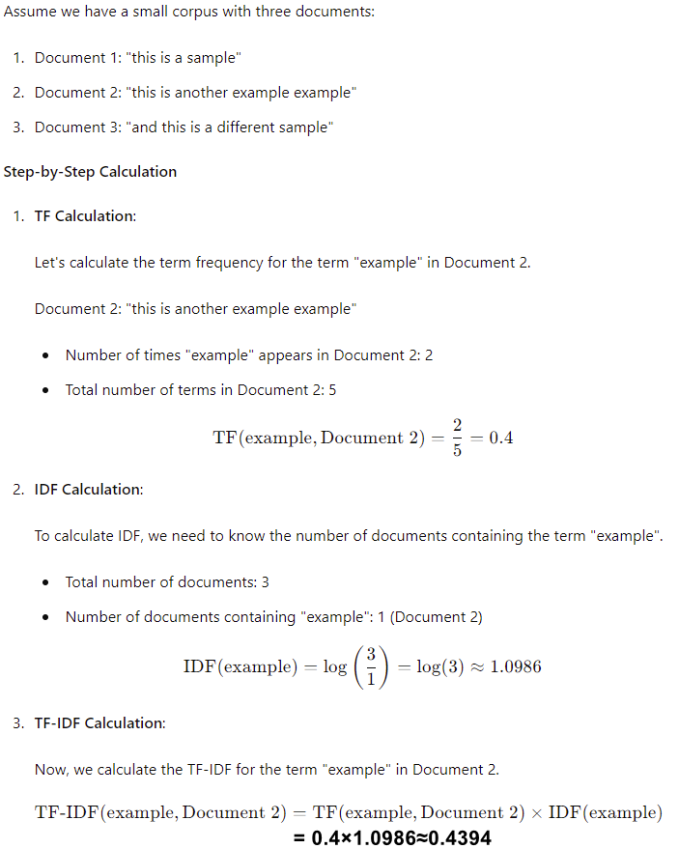
4. Word Embedding
TF-IDF:
Notes:
https://d2l.aivivn.com/chapter_natural-language-processing-pretraining/index_vn.html
https://viblo.asia/p/so-luoc-word-embedding-gDVK2RAeKLj
https://vinbigdata.com/kham-pha/word-embedding-so-sanh-cac-cach-tiep-can-truyen-thong-va-hien-dai.html

Slide 23
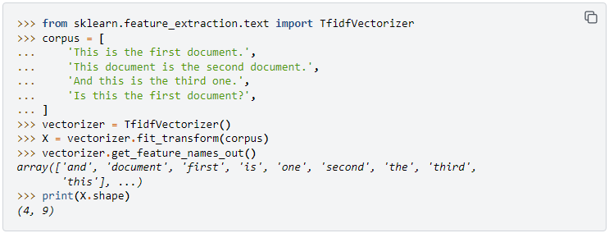
4. Word Embedding
TF-IDF:
Notes:
https://d2l.aivivn.com/chapter_natural-language-processing-pretraining/index_vn.html
https://viblo.asia/p/so-luoc-word-embedding-gDVK2RAeKLj
https://vinbigdata.com/kham-pha/word-embedding-so-sanh-cac-cach-tiep-can-truyen-thong-va-hien-dai.html

Slide 24
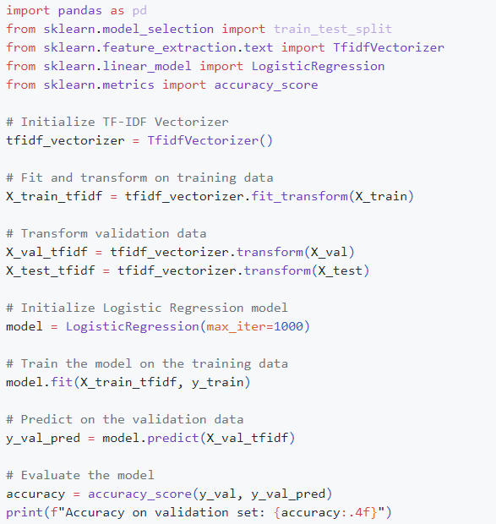
4. Word Embedding
TF-IDF:
Notes:
https://d2l.aivivn.com/chapter_natural-language-processing-pretraining/index_vn.html
https://viblo.asia/p/so-luoc-word-embedding-gDVK2RAeKLj
https://vinbigdata.com/kham-pha/word-embedding-so-sanh-cac-cach-tiep-can-truyen-thong-va-hien-dai.html

Slide 25
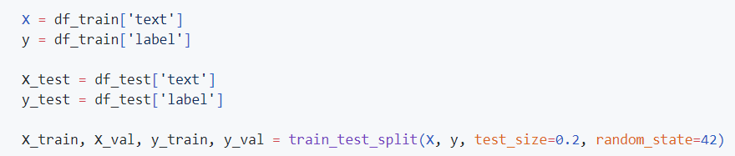
5. Splitting Data
Split dataset into training and validation (and possibly test) sets

Slide 26
6. Model Building
Logistic Regression: Simple and effective for many text classification tasks
Naive Bayes: Particularly effective for small datasets and text data
SVM (Support Vector Machine): Effective for high-dimensional spaces
Neural Networks:
Multi-Layer Perceptron
RNNs/LSTMs: Suitable for sequence data
CNNs: Can capture local patterns in text
Transformers: State-of-the-art models like BERT for capturing contextual information

Slide 27
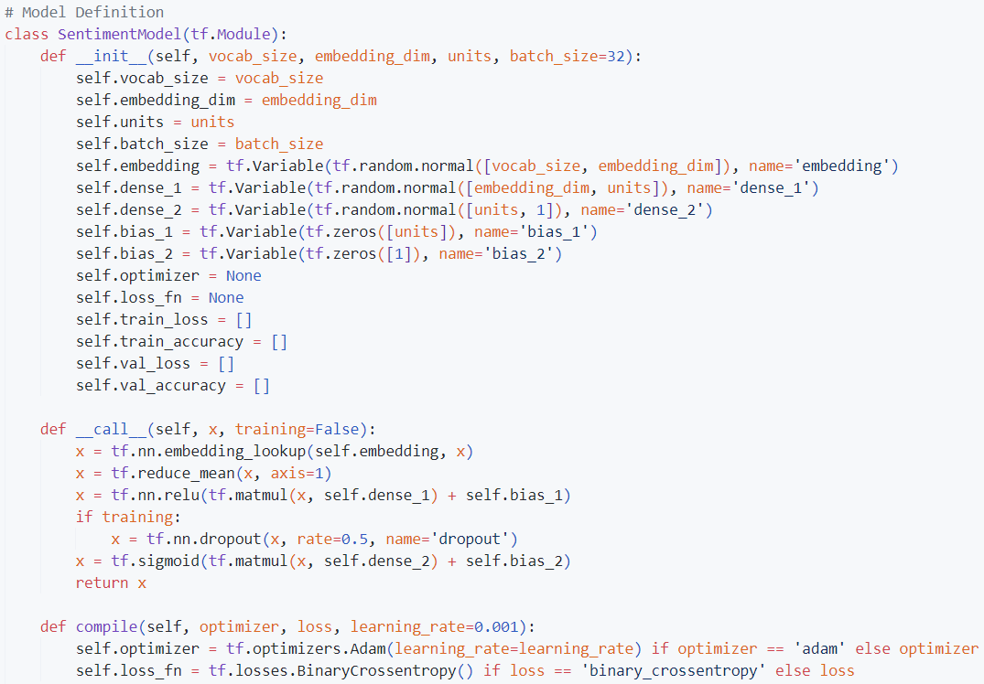
6. Model Building
MLP
Custom Layers

Slide 28
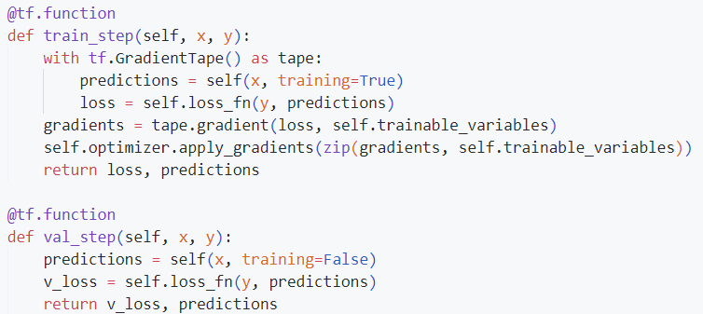
6. Model Building
MLP
Custom Layers

Slide 29
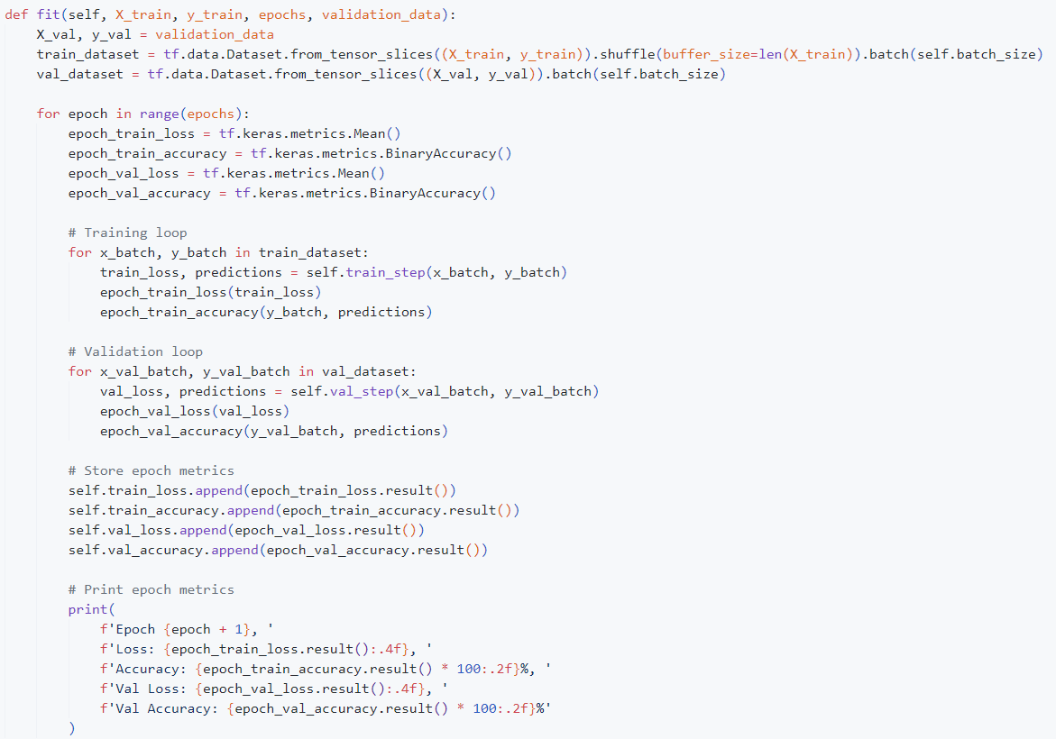
6. Model Building
MLP
Custom Layers

Slide 30
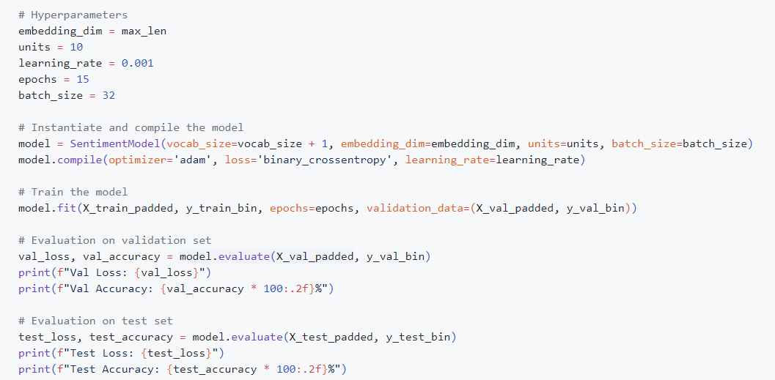
7. Model Training
Train model on the training data

Slide 31
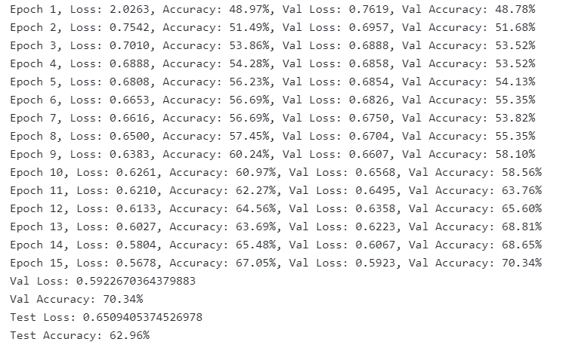
7. Model Training
Monitor performance on the validation set
Train data size 2616:

Slide 32
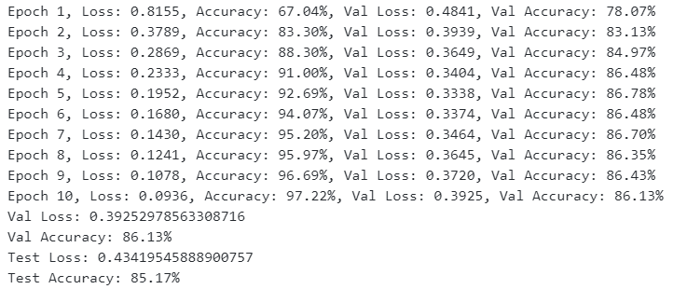
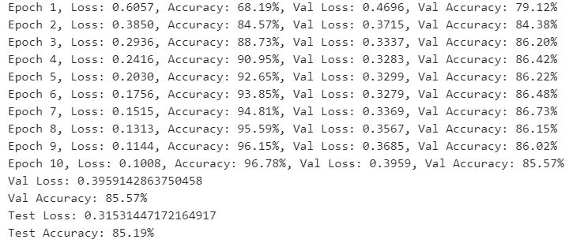
7. Model Training
Train data size 24000:

Slide 33
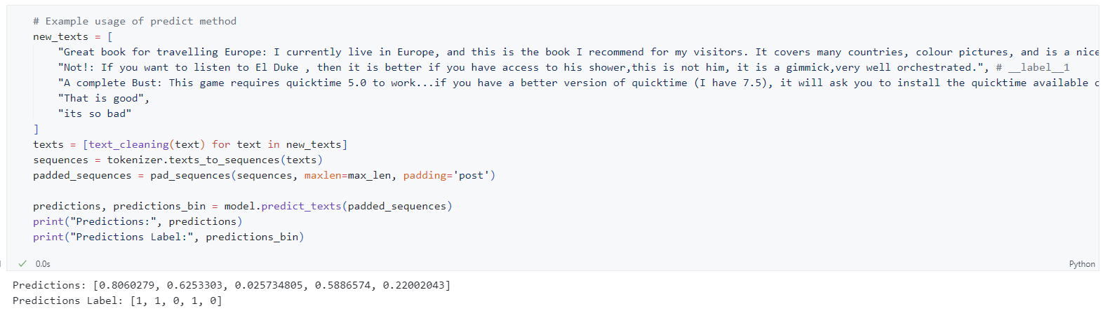
8. Model Evaluation
Evaluate model using sample texts

Slide 34
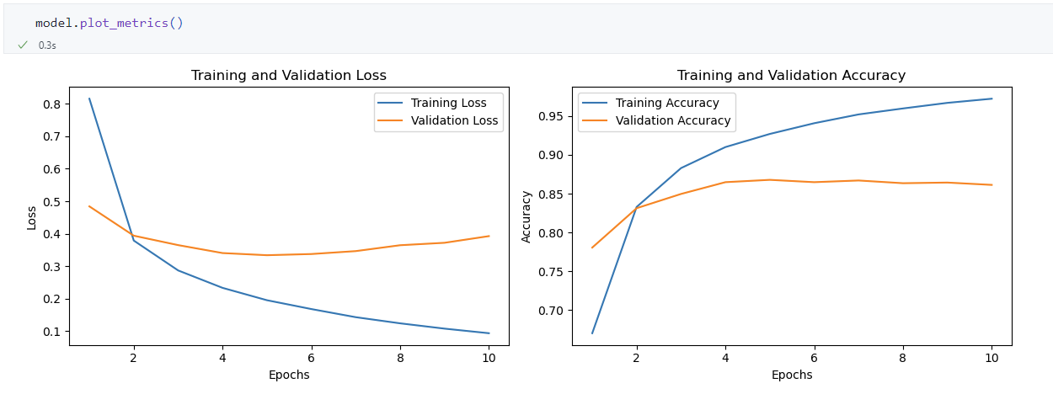
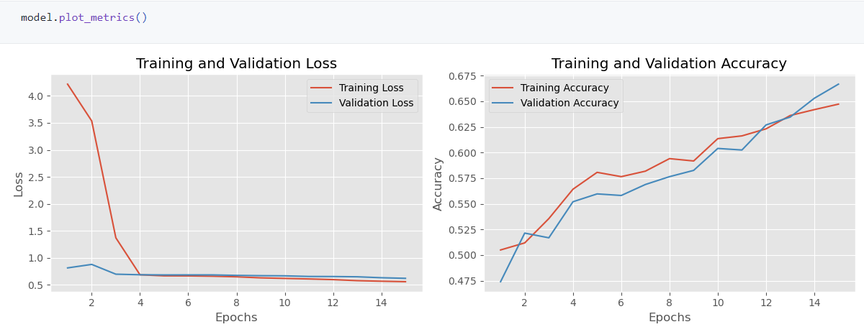
8. Model Evaluation
Plot train and validation data

Slide 35
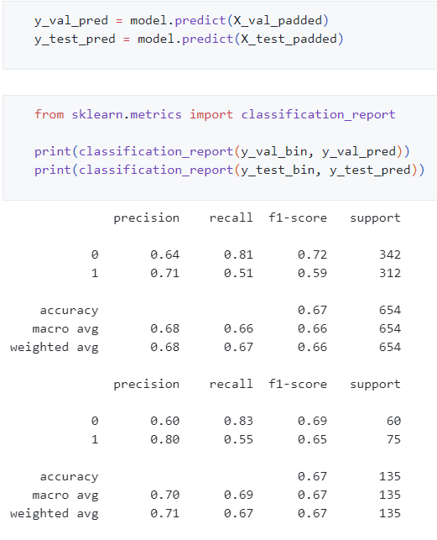
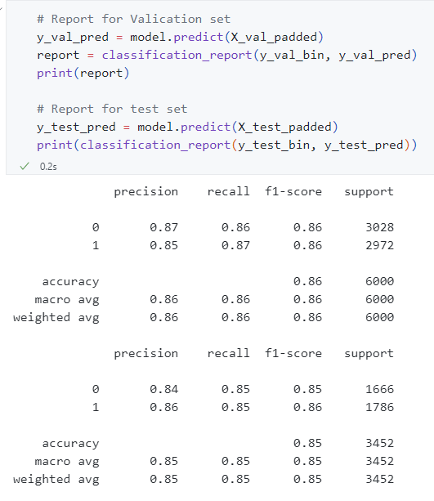
8. Model Evaluation
Evaluate model using metrics: accuracy, precision, recall, F1-score

Slide 36
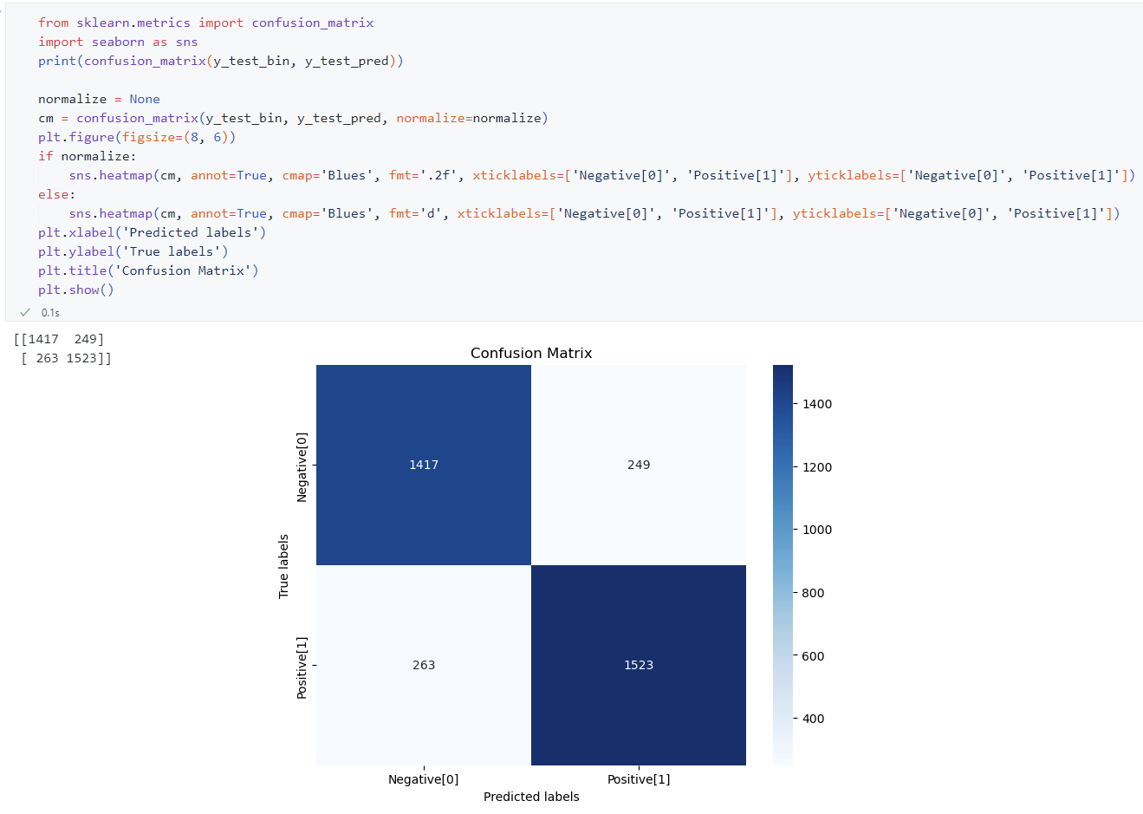
8. Model Evaluation
Use confusion matrix to understand the errors: Refer the notebook

Slide 37
9. Q&A

Slide 38
THANK YOU !

Slide 39
Back Up Slide
Back Up Slide

Slide 40
Classification vs Sentiment Analysis
Classification - Classification is a type of supervised learning where the goal is to predict the categorical class labels of new instances based on past observations. It involves assigning inputs to one of several predefined categories.
Sentiment Analysis - Sentiment analysis is a subfield of natural language processing (NLP) focused on determining the sentiment expressed in text. It typically involves classifying text into categories such as 'positive', 'negative', or 'neutral'.

Slide 41
Classification vs Sentiment Analysis
Classification: This is a broad category in machine learning that involves categorizing data into predefined labels or classes. It can be applied to various types of data such as text, images, numerical data, etc. The primary goal is to predict the category to which a new observation belongs based on a model trained on labeled data.
Sentiment Analysis: This is a specialized type of classification specifically focused on text data. The goal is to determine the sentiment expressed in the text, typically categorizing it as positive, negative, or neutral. It deals primarily with understanding emotions, opinions, and attitudes conveyed in written language.

Slide 42
Classification vs Sentiment Analysis
Classification: General task of assigning inputs to categories; applicable to various data types and domains.
Sentiment Analysis: Specialized form of classification focused on determining sentiment in textual data.

Slide 43
Classification vs Sentiment analysis
Classification: Spam Detection
Sentiment Analysis : Product Reviews

Slide 44
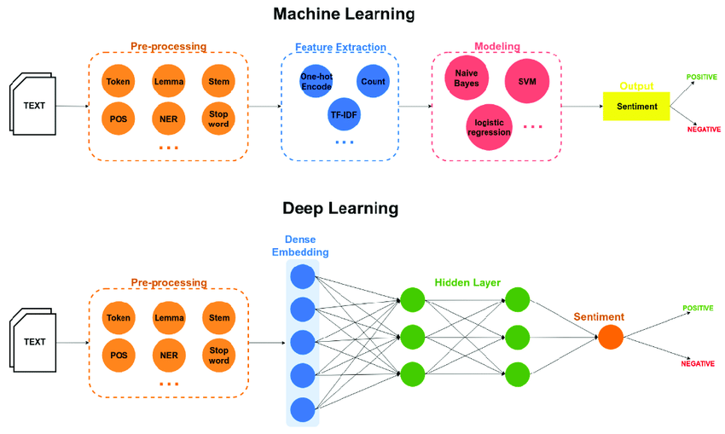
Classification vs Sentiment Analysis

Slide 45
SƠ LƯỢC WORD EMBEDDING
1. Khái niệm: Word Embedding là tên gọi chung của các mô hình ngôn ngữ và các phương pháp học theo đặc trưng trong Xử lý ngôn ngữ tự nhiên(NLP), ở đó các từ hoặc cụm từ được ánh xạ sang các vector số (thường là số thực). Đây là một công cụ đóng vai trò quan trọng đối với hầu hết các thuật toán, kiến trúc Machine Learning, Deep Learning trong việc xử lý Input ở dạng text, do chúng chỉ có thể hiểu được Input ở dạng là số, từ đó mới thực hiện các công việc phân loại, hồi quy,vv….
2. Các loại Word Embedding
Word Embedding được phân chủ yếu thành 2 loại:
Frequency-based embedding: Count Vector, TF-IDF Vector, Co-occurrence Matrix, GloVe (Global Vector)
Prediction-based embedding: Word2vec (CBOW, Skip-gram), GloVe, FastText
Notes:
https://viblo.asia/p/so-luoc-word-embedding-gDVK2RAeKLj
https://d2l.aivivn.com/chapter_natural-language-processing-pretraining/index_vn.html
https://www.geeksforgeeks.org/word-embedding-techniques-in-nlp/
https://scikit-learn.org/stable/modules/generated/sklearn.feature_extraction.text.CountVectorizer.html
https://scikit-learn.org/stable/modules/generated/sklearn.feature_extraction.text.TfidfVectorizer.html

Slide 46
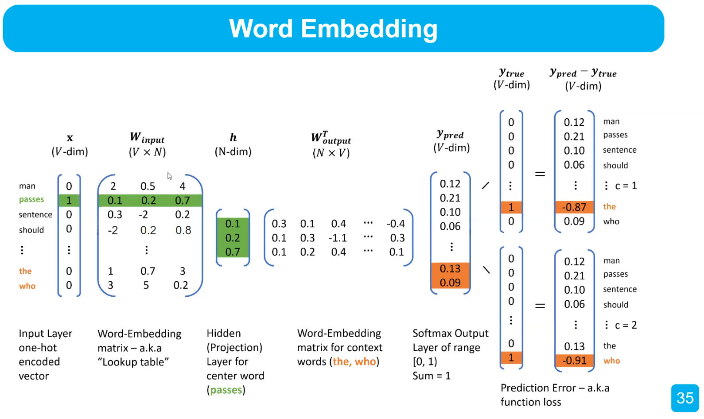
SƠ LƯỢC WORD EMBEDDING
Word2vec
Notes:
https://d2l.aivivn.com/chapter_natural-language-processing-pretraining/index_vn.html
https://viblo.asia/p/so-luoc-word-embedding-gDVK2RAeKLj
https://www.geeksforgeeks.org/word-embedding-techniques-in-nlp/

